Slide 1

Application monitoring
A cloud first strategy

Slide 2
Acceptance criteria:
- Cloud first strategy
- The use of infrastructure as code “IoC”
- Automation of dashboards
- Automation of agents
- Easy application integration
- Options to control spend

Slide 3
Tooling Selection:
- Cloud Services (AZURE & DATADOG)
- IoC options, like Terraform
- Datadog has a terraform provider

Slide 4
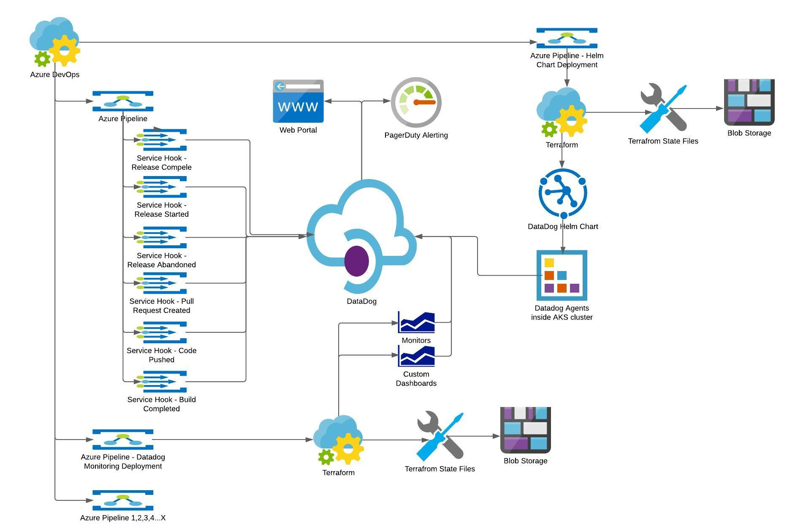
Datadog cloud monitoring

Slide 5
Rollout steps:
1. Define terraform code for deploying helm chart for Datadog agents to AKS clusters
- Place sensitive keys in AKS vault
- Define storage account for state file (lock down state)
2. Build a monitoring dashboard for kubernetes clusters
3. Integrate monitoring into Angular and Java apps.
- Test log shipping
- Test application performance with log levels.

Slide 6
Rollout steps:
4. Define log restrictions for application data. (Cost Limiting and Data Security)
- Create alerts for sensitive data based on regex
- Implement log Obfuscations
- Exclude namespaces
5. Integrate build metrics
- Create service hooks for build alerts
- Setup RUM monitoring
3. Integrate monitoring into Angular and Java apps.
- Test log shipping
- Test application performance with log levels.

Slide 7
Pain Points:
- Agent image sizes
- Testing log obfuscations for passing data to Datadog
- Automation for service tooks in azure
- Dashboarding release metrics

